Slide 1
Build a Strong MERN Foundation
Notes:
Trainer Notes:
This slide is self-explanatory, trainer notes not required.

Slide 2
Online Banking Web Application

Slide 3
Designing the Online Banking Application

Slide 4


Before we begin, let’s recall what we have covered till now:​

Slide 5
HTML5
HTML, or Hyper Text Markup Language, is the standard markup language used to create web pages. It structures content on the web and is the backbone of all websites, defining elements like headings, paragraphs, links, and images.
CSS
CSS, or Cascading Style Sheets, is a style sheet language used for describing the look and formatting of a document written in HTML or XML. It provides a more efficient way to design web pages and allows changes to be made in one place that updates across the whole site.

Slide 6
A Day in the Life of a MERN Stack Developer
The planning of the project is done by employing the Agile methodology and the project is shifting toward its development stage.
The first step will be to design a static web page for the banking application using HTML5 and CSS.

Slide 7

Identify basic HTML tags and CSS properties used to design a web application
Utilize HTML and CSS to create basic elements of a banking website
Examine and debug the code for common issues in web layout and styling
Design and build a functional web application for a banking site using HTML and CSS

Slide 8
Task: Create the Static Web Application Using HTML and CSS

Slide 9
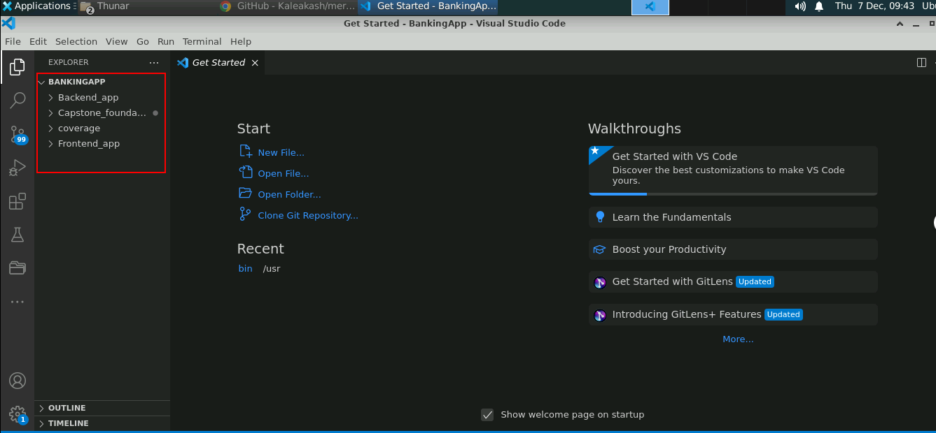
Create the Basic Web Application Structure
Open the project structure with VS Code

Slide 10
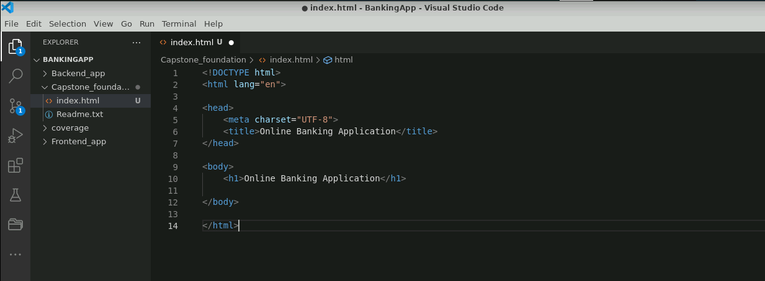
Create the Basic Web Application Structure
Create a simple HTML file named index.html inside the Capstone_foundation directory

Slide 11
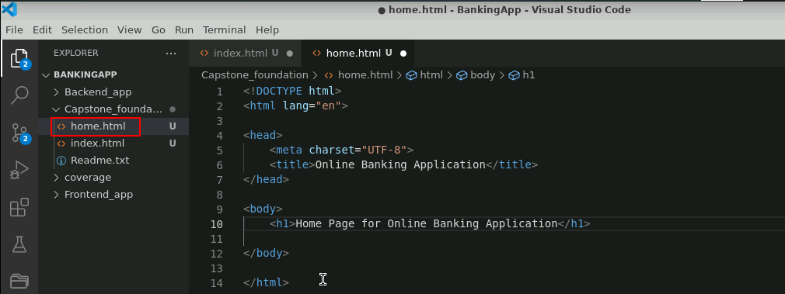
Create the Basic Web Application Structure
Create a simple HTML page to serve as the home page of the web application

Slide 12
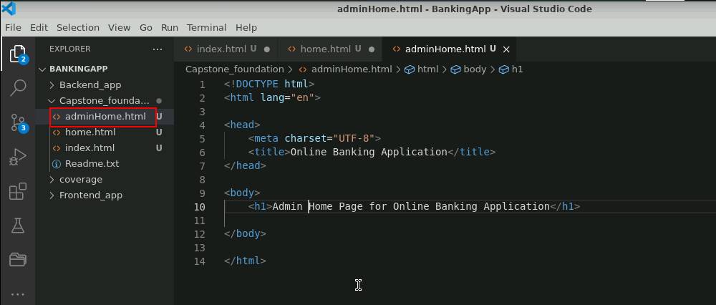
Create the Basic Web Application Structure
Create a simple HTML page to serve as the admin home page of the web application

Slide 13
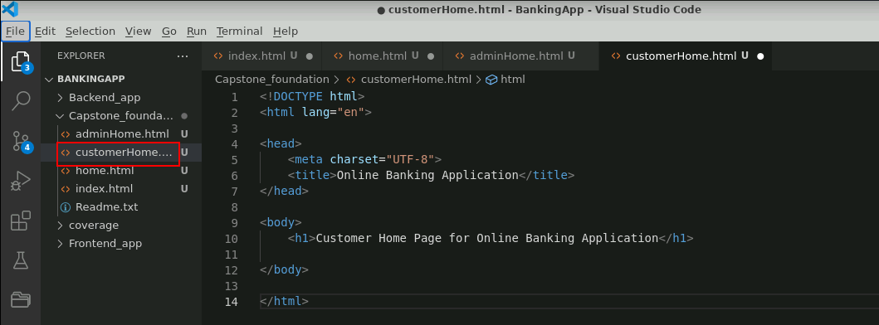
Create the Basic Web Application Structure
Create a simple HTML page to serve as the customer home page of the web application

Slide 14
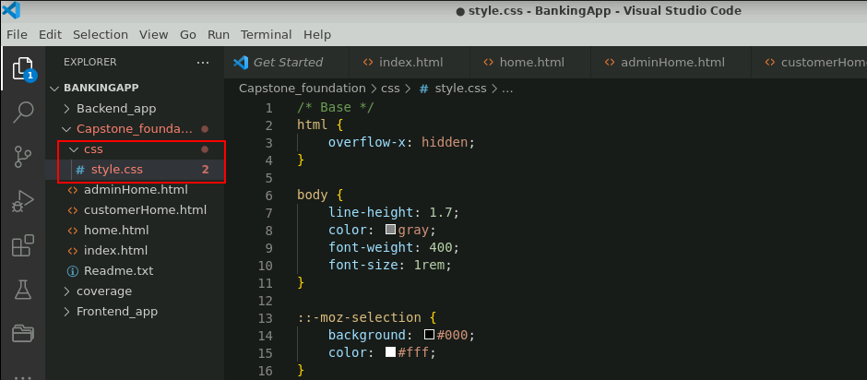
Create the Basic Web Application Structure
Make a css folder and create a style.css file in it to add external CSS properties

Slide 15
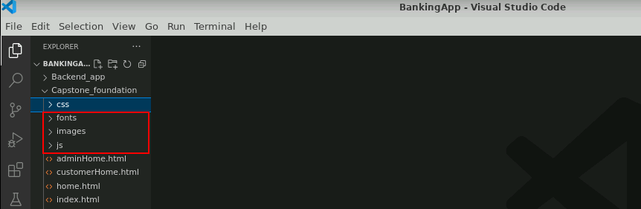
Create the Basic Web Application Structure
Create fonts, images, and js folders to store all necessary external resources

Slide 16
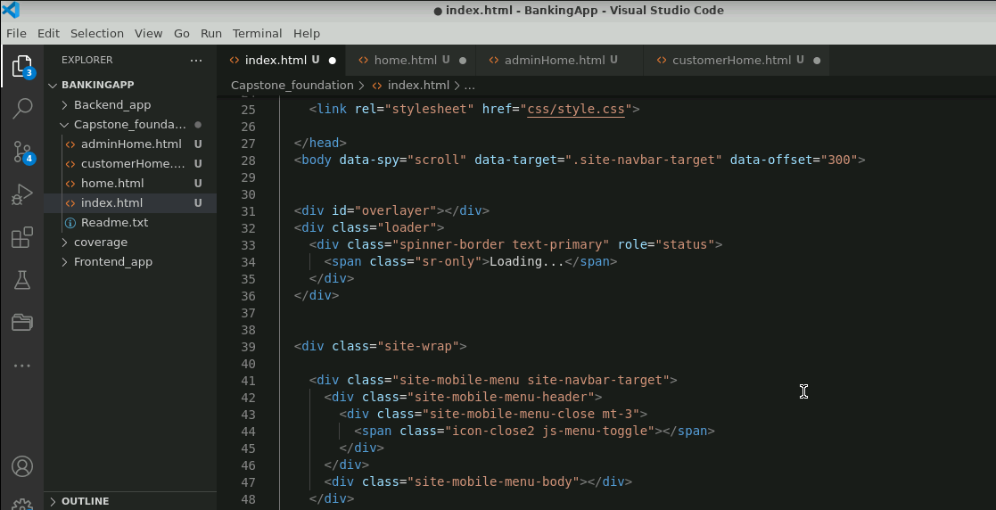
Modify the index.html Page
Modify the index.html file by adding HTML elements and CSS properties to create the following components: Home, About Us, Blogs, and Contact Us.

Slide 17
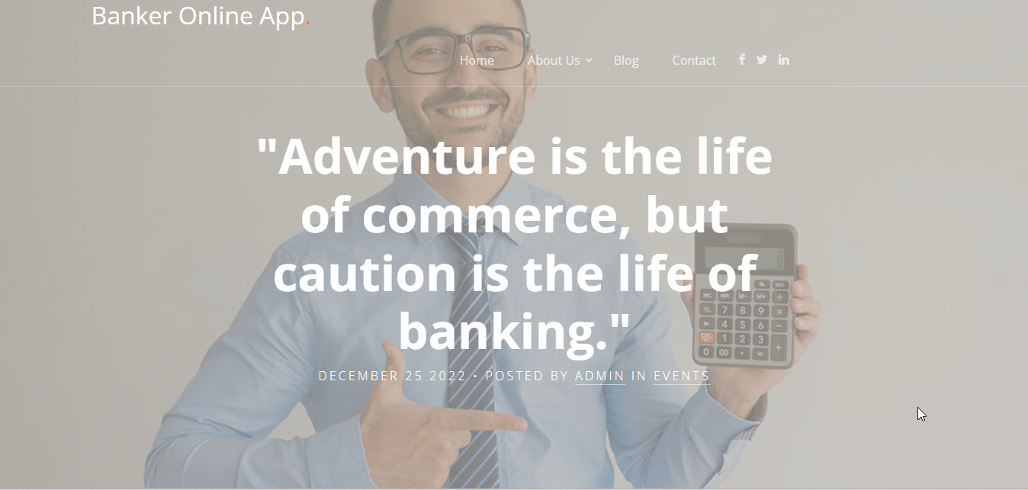
Modify the index.html File
This is a sample output of the index.html page which acts as the landing page of the banking web application.

Slide 18
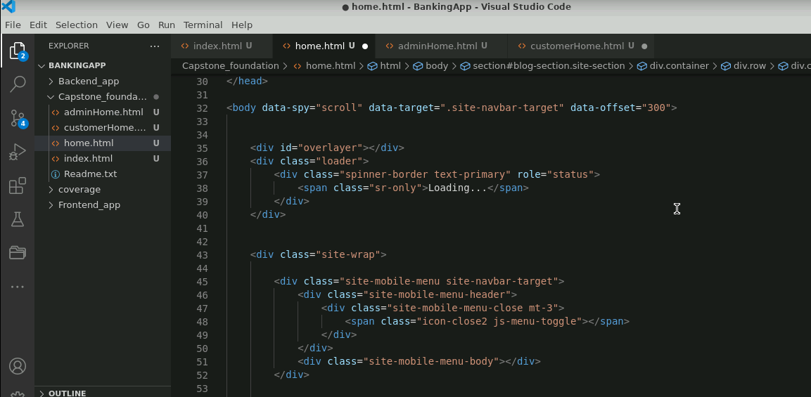
Modify the home.html File
Modify the home.html file by adding HTML elements and CSS properties to create the following sections: Login, About Us, Services, Blogs, and Contact Us
Notes:
Modify the index.html file by adding HTML elements and CSS properties to create the following components: Home, About Us, Blogs, and Contact Us.

Slide 19
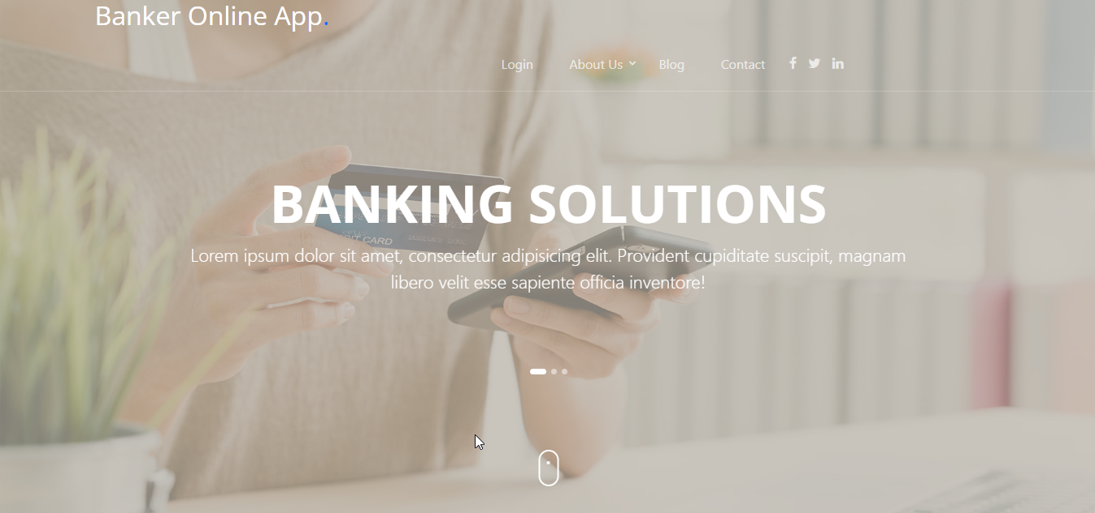
Modify the home.html File
This is a sample output of the home.html page.

Slide 20
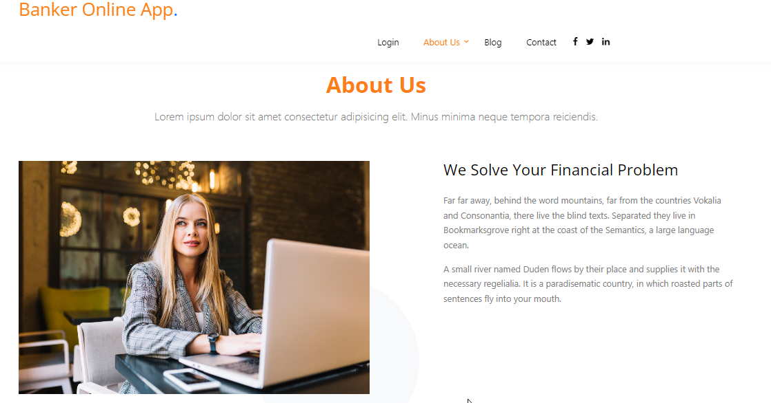
Modify the home.html File
This is a sample output of the About Us section.

Slide 21
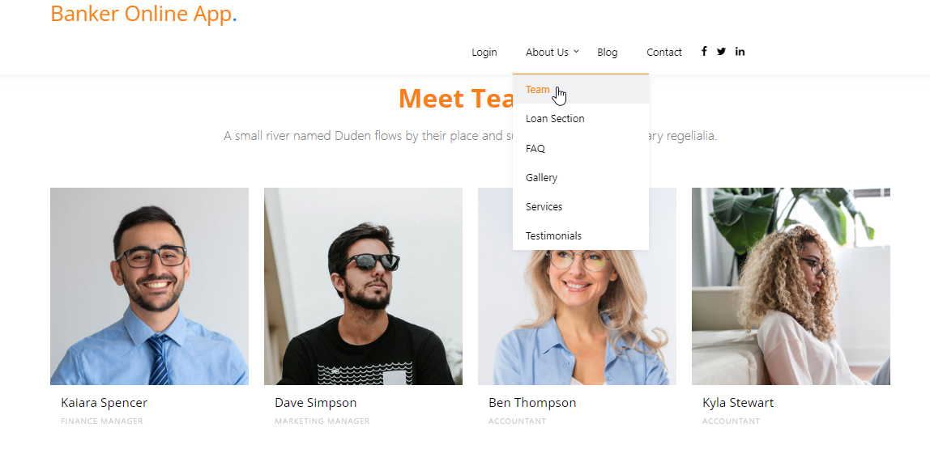
Modify the home.html File
This is a sample output of the About Us > Team section.

Slide 22
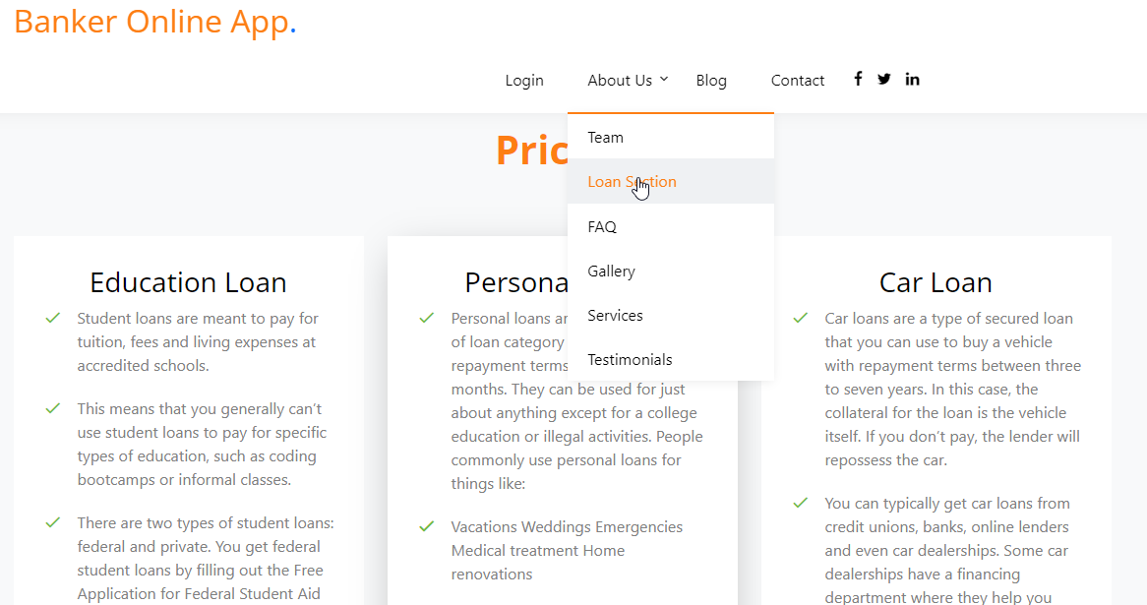
Modify the home.html File
This is a sample output of the About Us > Loan Section.

Slide 23
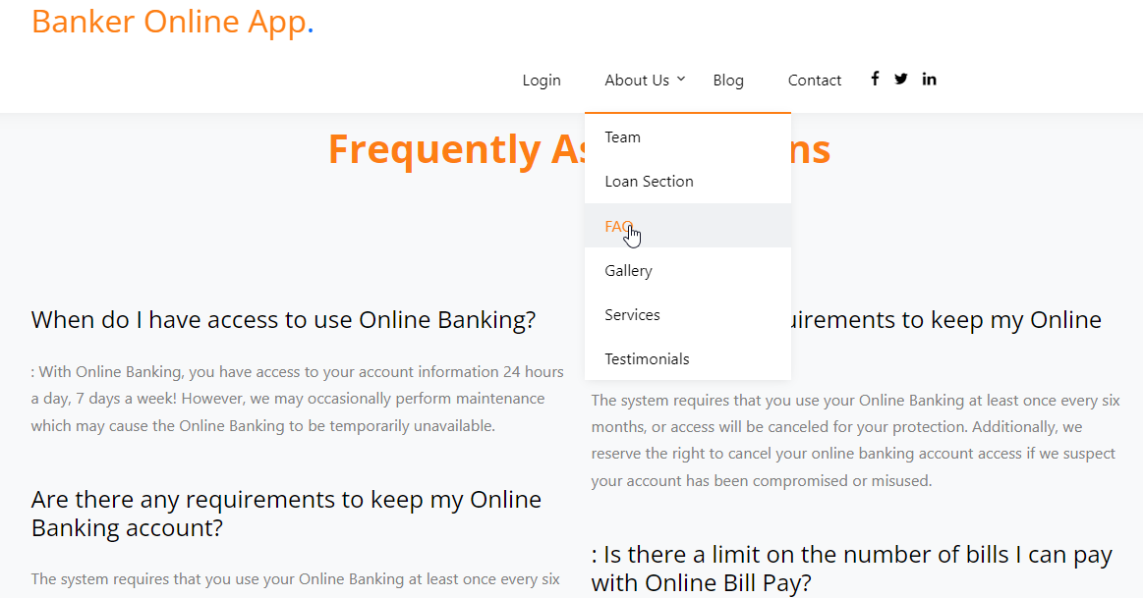
Modify the home.html File
This is a sample output of the About Us > FAQs section.

Slide 24
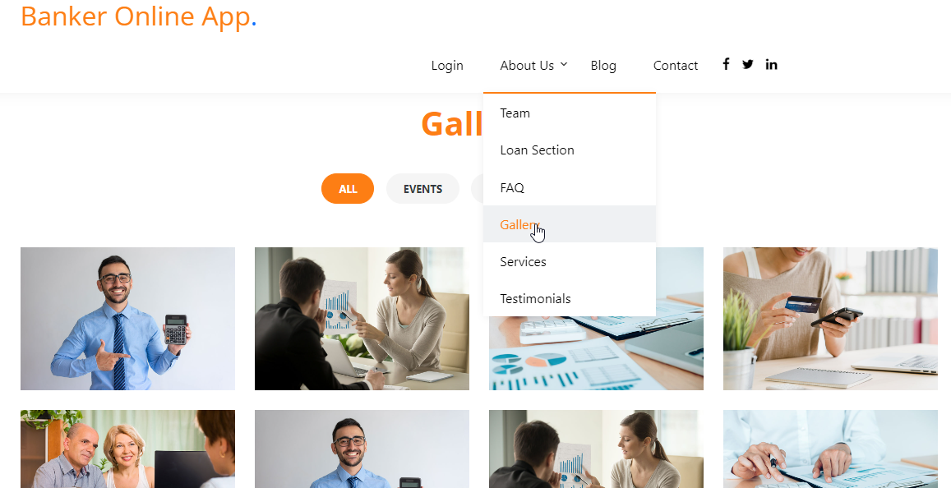
Modify the home.html File
This is a sample output of the About Us > Gallery section.

Slide 25
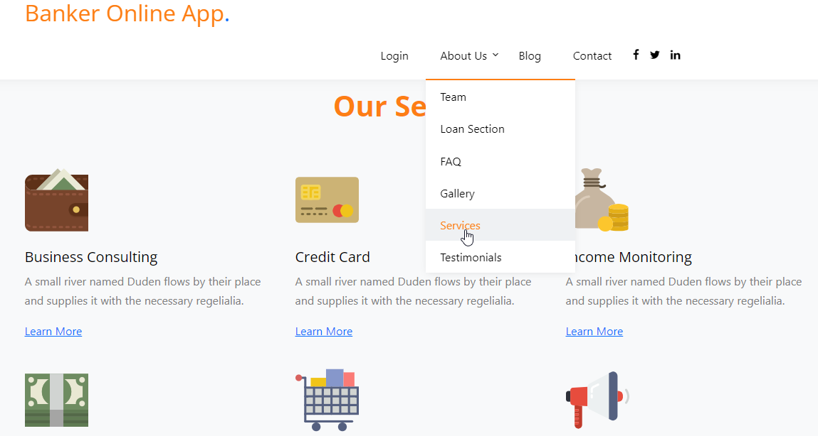
Modify the home.html File
This is a sample output of the About Us > Our Services section.

Slide 26
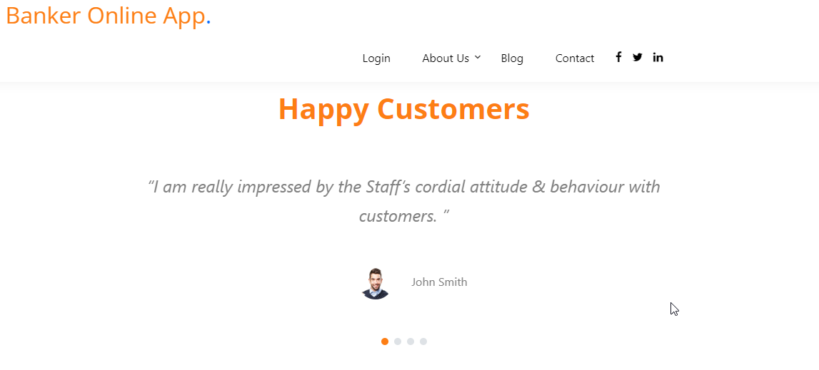
Modify the home.html File
This is a sample output of the About Us > Testimonials section.

Slide 27
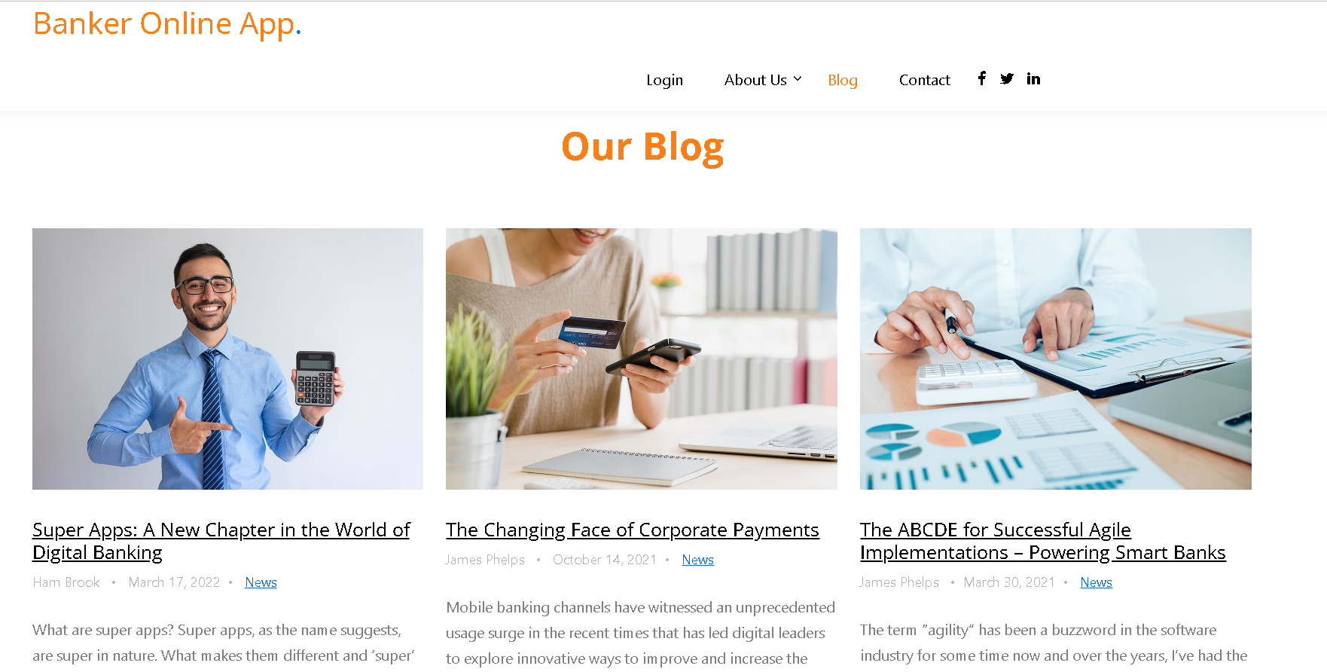
Modify the home.html File
This is a sample output of the Blogs section.

Slide 28
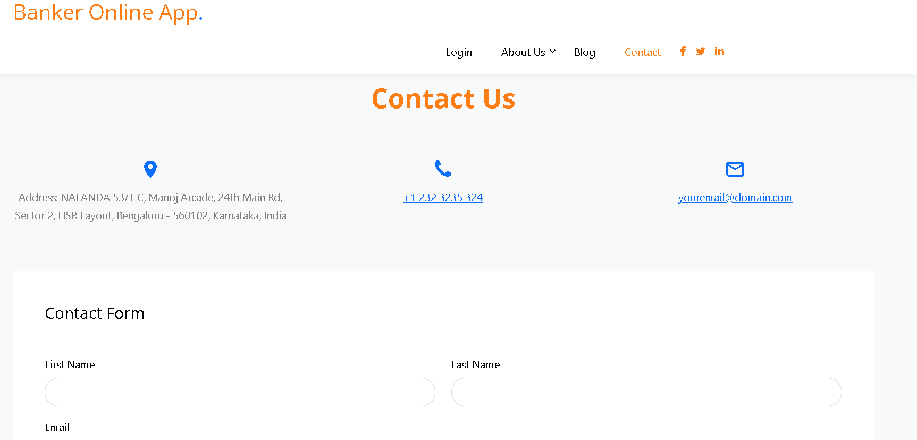
Modify the home.html File
This is a sample output of the Contact Us section.

Slide 29
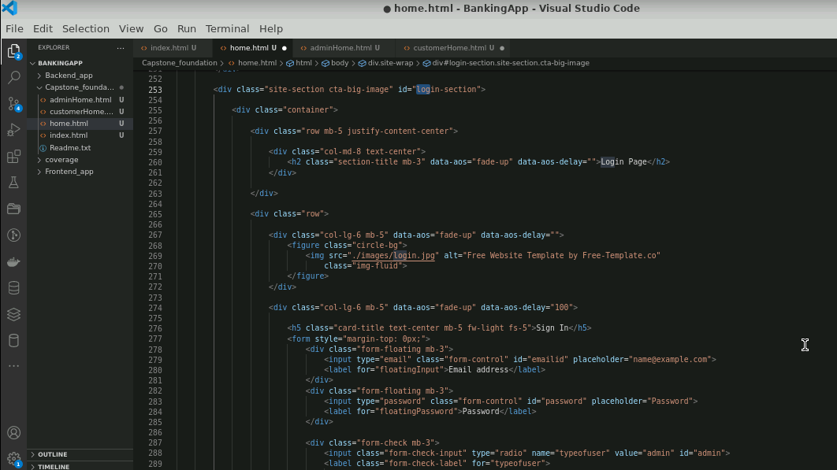
Modify the home.html File
Add login section which have the functionality of both admin and customer login

Slide 30
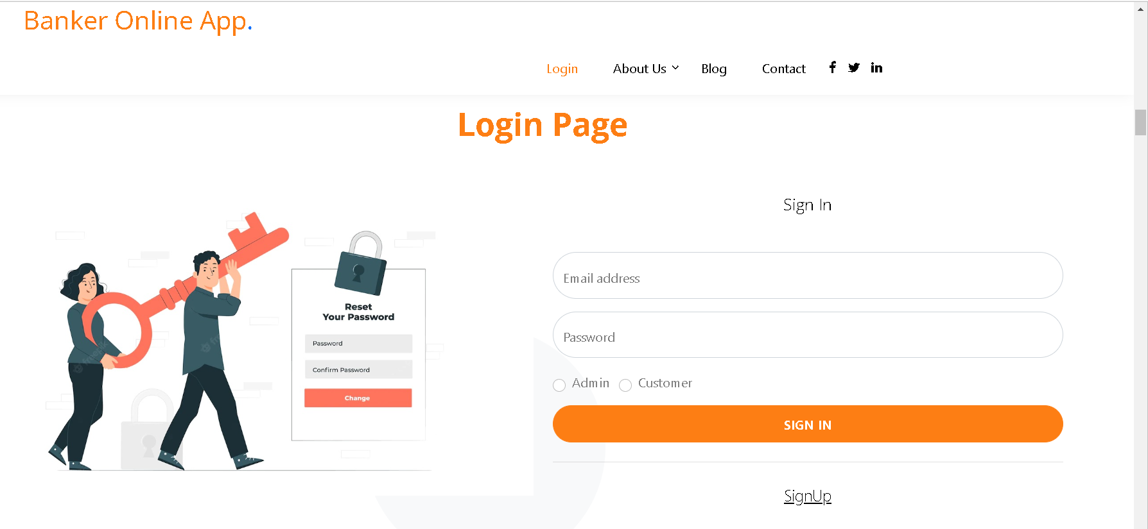
Modify the home.html File
This is a sample output of the Login Page section.

Slide 31
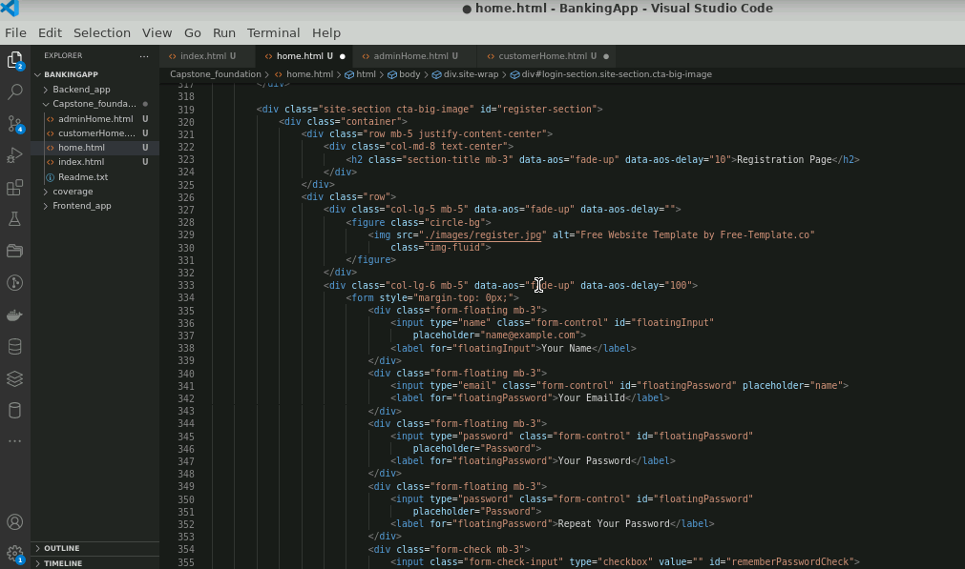
Modify the home.html File
Add a Registration section that shows up when the new customers want to sign up

Slide 32
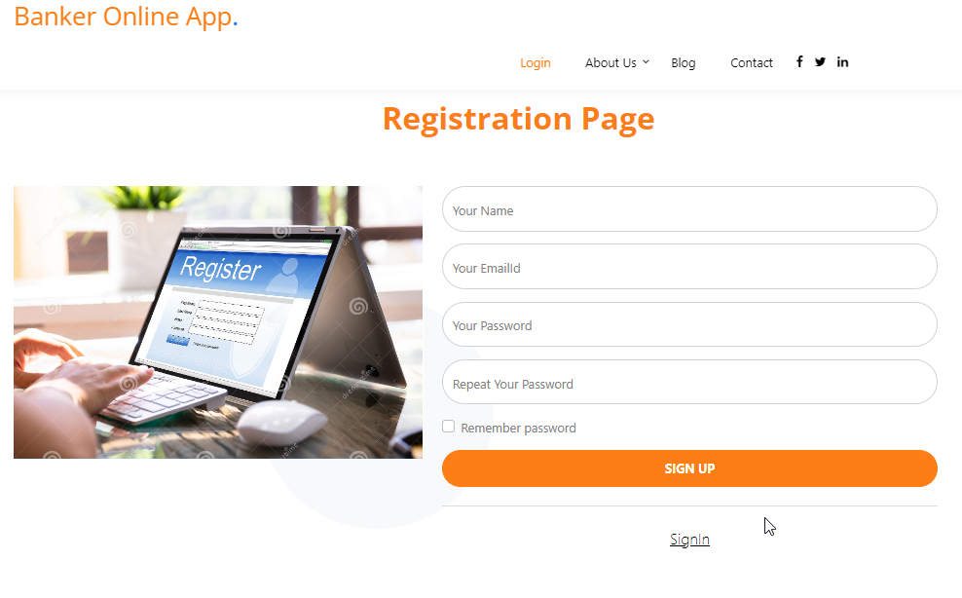
Modify the home.html File
This is a sample output of the Registration Page section.

Slide 33
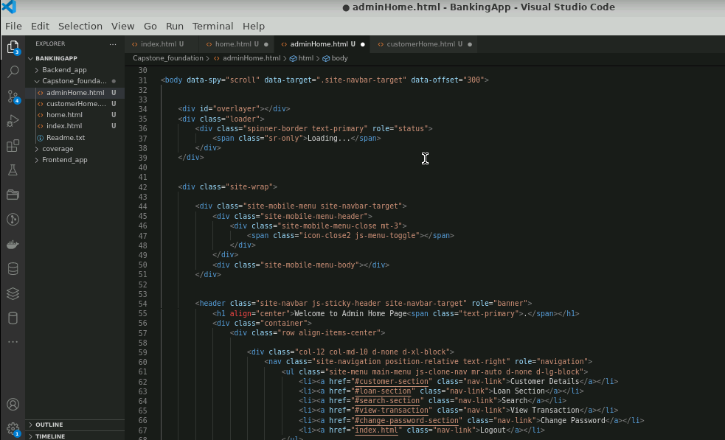
Modify the adminHome.html File
Modify the adminHome.html file to display different sections like customer details, loan section, search, and view transaction

Slide 34
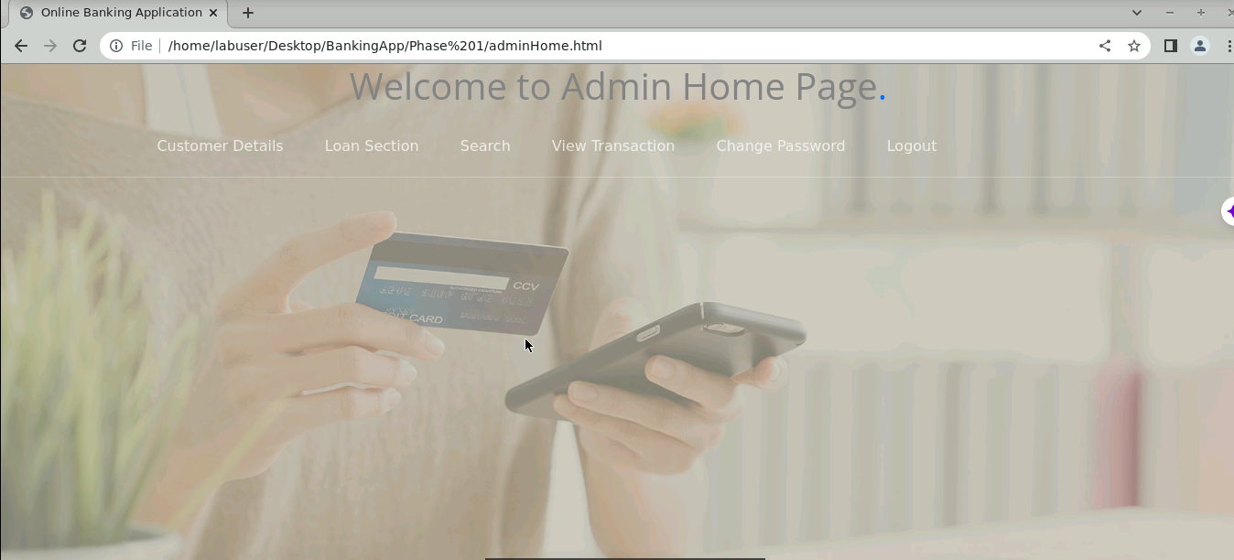
Modify the adminHome.html File
This is a sample output of the adminHome.html page.

Slide 35
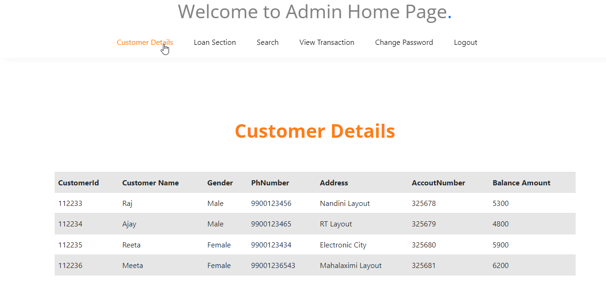
Modify the adminHome.html File
This is a sample output of the Customer Details section.

Slide 36
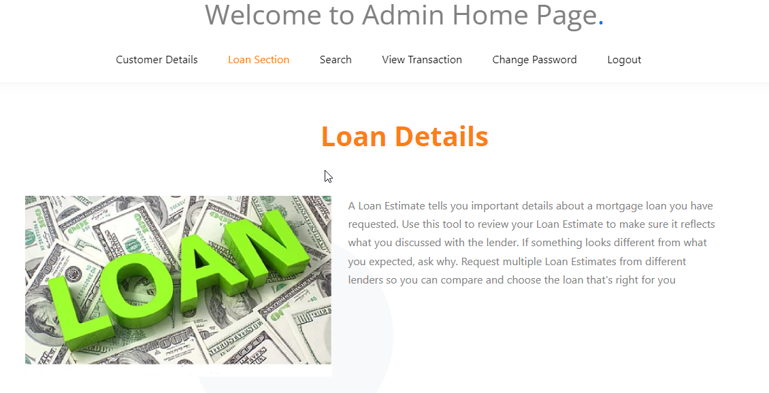
Modify the adminHome.html File
This is a sample output of the Loan Details section.

Slide 37
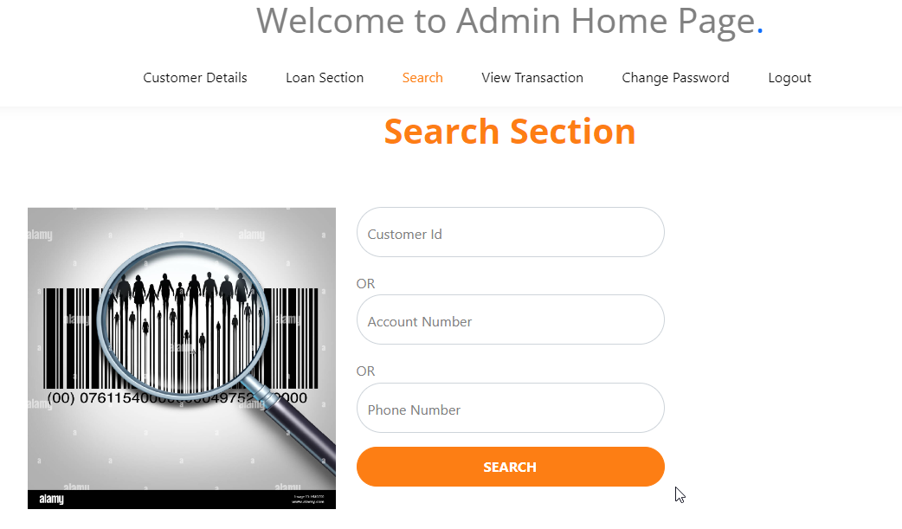
Modify the adminHome.html File
This is a sample output of the Search section, where the admin can search for customer details using the Customer Id, Account Number, or Phone Number.

Slide 38
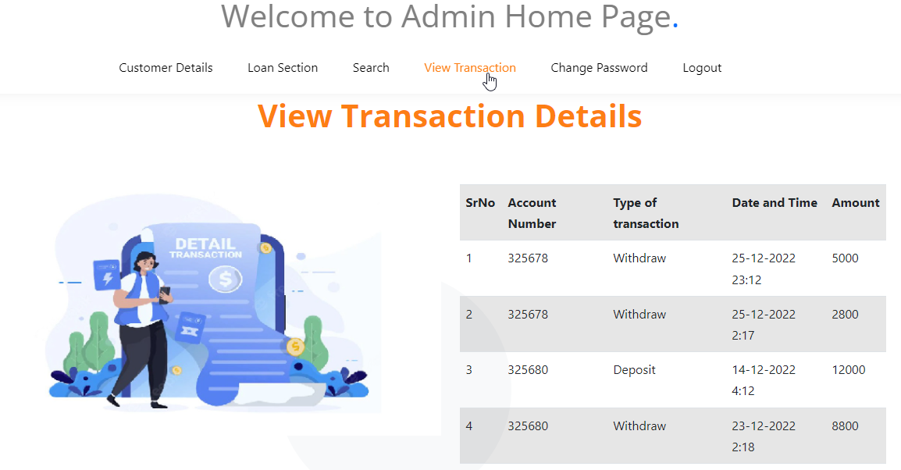
Modify the adminHome.html File
This is a sample output of the View Transaction Details section.

Slide 39
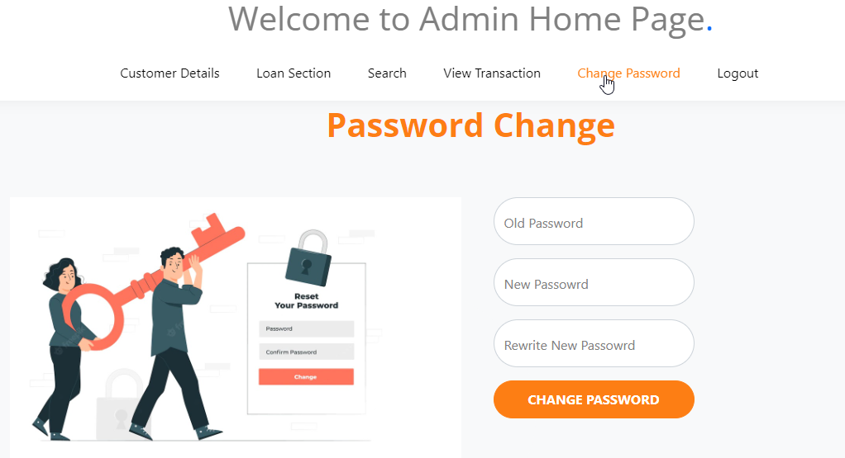
Modify the adminHome.html File
This is a sample output of the Password Change section.
When the Logout option is selected, the application gets redirected to the Home page

Slide 40
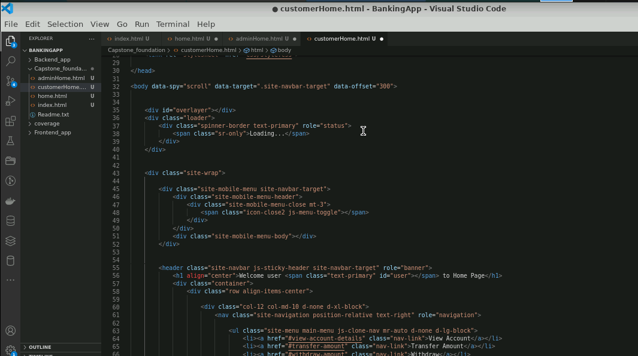
Modify the customerHome.html File
Modify the customerHome.html file to display different sections like view account, transfer amount, withdraw details, deposit details, and view transaction.

Slide 41
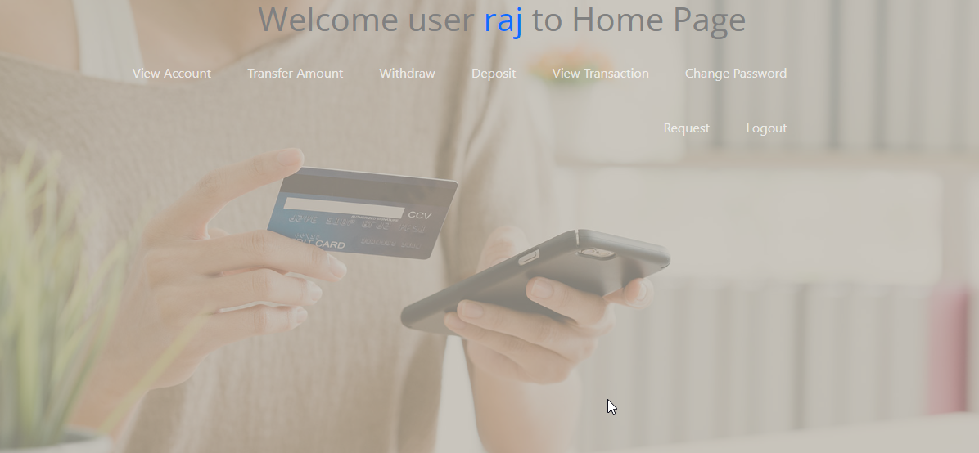
Modify the customerHome.html File
This is a sample output of the customerHome.html page.

Slide 42
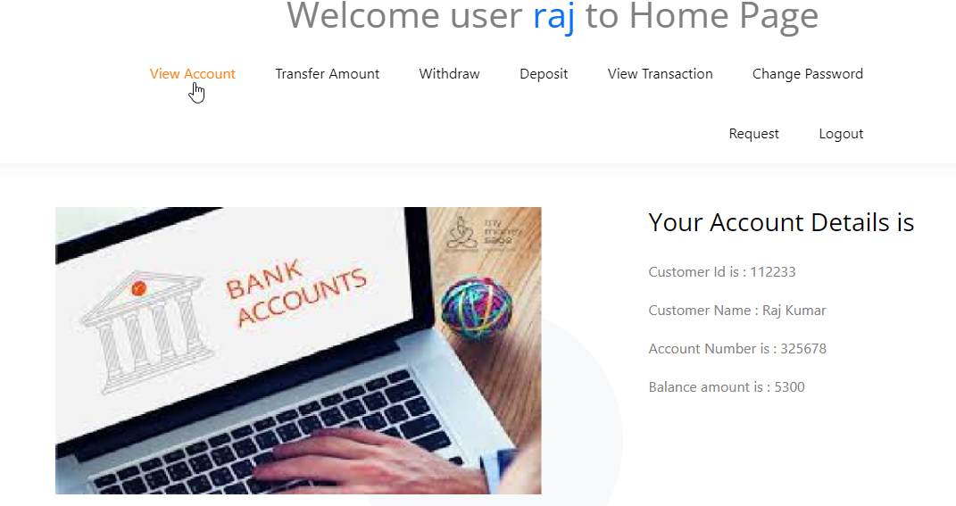
Modify the customerHome.html File
This is a sample output of the View Account section.

Slide 43
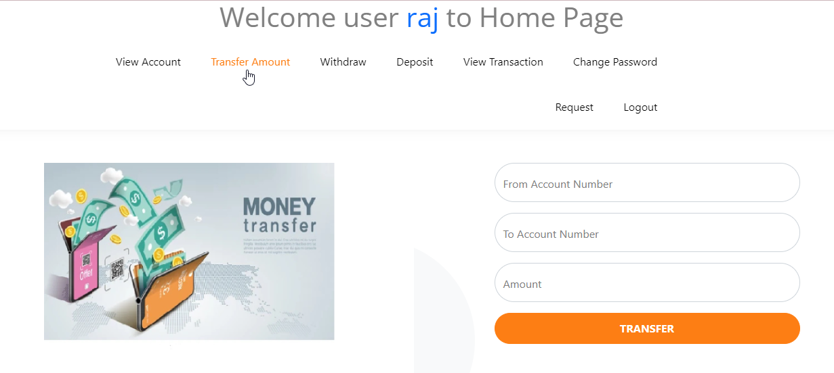
Modify the customerHome.html File
This is a sample output of the Transfer Amount section.

Slide 44
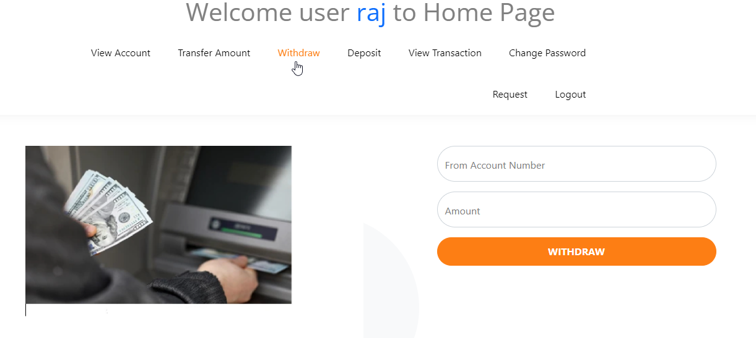
Modify the customerHome.html File
This is a sample output of the Withdraw section.

Slide 45
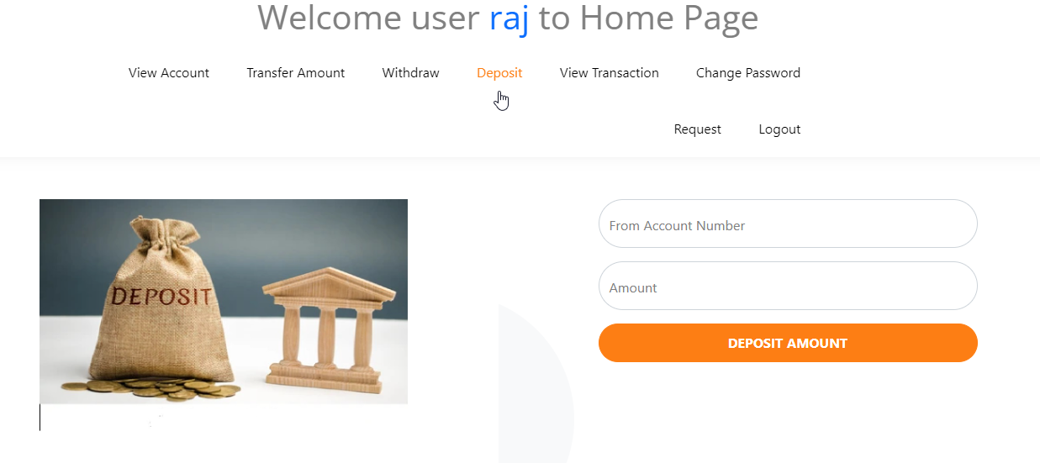
Modify the customerHome.html File
This is a sample output of the Deposit section.

Slide 46
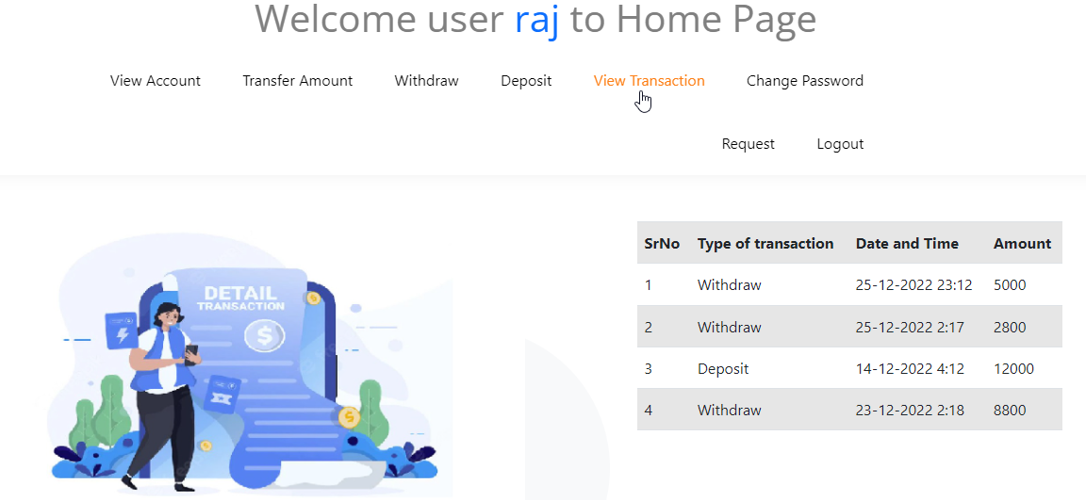
Modify the customerHome.html File
This is a sample output of the View Transaction section.

Slide 47
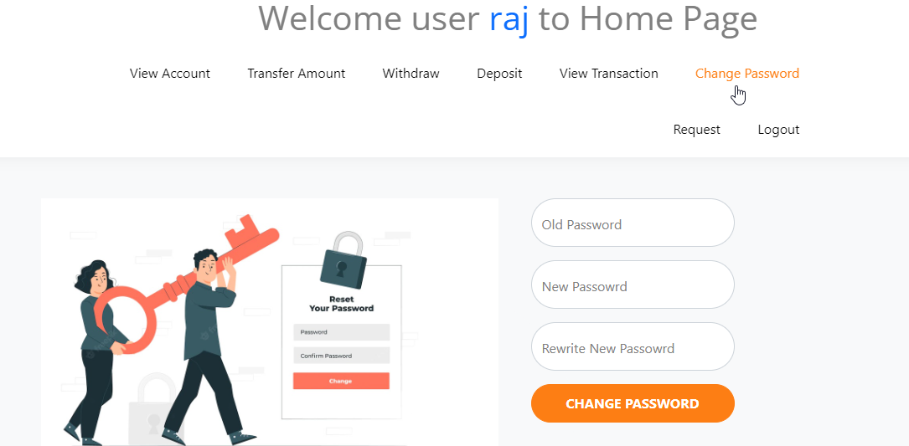
Modify the customerHome.html File
This is a sample output of the Change Password section.

Slide 48
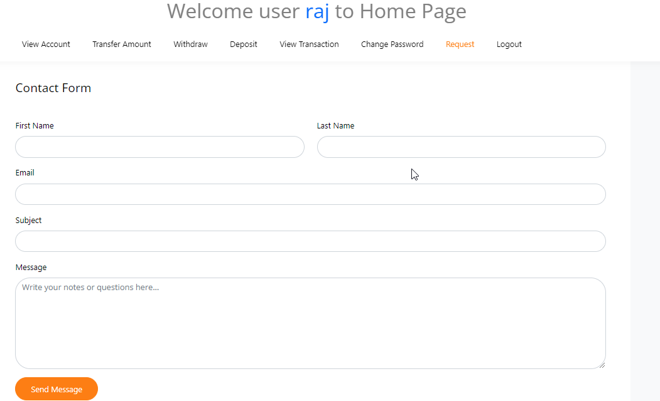
Modify the customerHome.html File
This is a sample output of the Request section.
When the Logout option is selected, the application gets redirected to the Home page

Slide 49
Conclusion
By the end of the session, it is expected that:
All the required HTML pages are created based on the user stories written using Agile.
All HTML pages are connected using a hyperlink or button.
All forms required for the HTML pages are created based on the type of web page.
All the web pages must show static data for the banking web application.
All web pages should use static styling, which can be applied using various types of CSS.

Slide 50
Thank you

